Slide 1

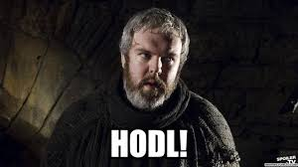
IST 303 Team Project: Part C HODL (Hold On, Don’t Liquidate) App
Team Members:
Eman Alzahrani, Marcus Dashoff,
Raymond Derrick Dimla,
James Hah, Chen Zhu

Slide 2
Project Overview:
Developing a simple stock trading app that allows users to:
✅ Buy and sell stocks
✅ View their portfolio
✅ Cancel unfulfilled orders
✅ Analyze market trends
Key Focus:
Real-time stock price updates 📈
Market trends and news 📰
Order management (buy, sell, cancel) 💸

Slide 3

What We Achieved in Milestone 1:
📊 User authentication (login/logout).
📂 Database setup for users and stock trades.
💸 Buy and sell order functionality.
📈 Stock search and market info display.
👉 Next, we'll walk you through these features in detail.

Slide 4
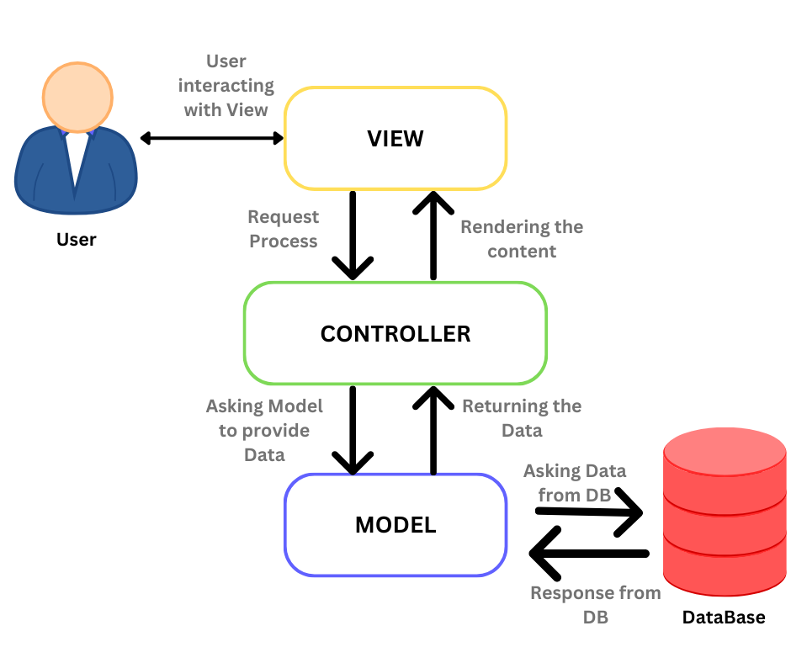
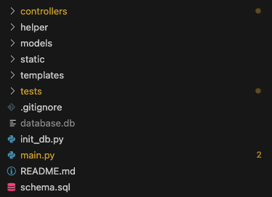
Basic Setup
Website
(HTML + CSS)
Design pattern
Model View Controller (MVC)
Splits responsibility of program into parts.
Business Logic of OOP stays in main python program
The Website and be worked on separately than the main python codebase. The SQL logic can be worked on separately from the website or controller program.
“Main” Python Program (Python)
Database (SQL)

Slide 5
User Story 1 – Dashboard
I want to be able to login manage my stock trades, have proper labels such as tickers, ids, and date times recording my activities. My session are secured, and my profile is saved when I leave or log out.

Slide 6
Kickoff – Environment Setup - Tasks
User DB Table Setup
user (id, email, balance, password)
Stock Trade DB Table Design and Setup
Stock Schema: stock (id, ticker, full_name)
Purchase & Sell Schema:
purchase (id, user_id, stock_id, price, datetime, fulfilled_by_id, is_canceled)
sell (id, user_id, stock_id, price, datetime, fulfilled_by_id, is_canceled)
User Authentication
User login with session setting
User logout with session unsetting
Navigation Setup
Page tabs: Main, Sell, Buy, Info

Slide 7
Software Demonstration
What the code does
How it fulfills the user stories

Slide 8
User Story 2 - Search Stock Information
I want an Info Page where I can search for a stock by entering a ticker and clicking submit to view buy sell data. The page should display the last price, highest and lowest historical prices. A refresh button may be added later for manual updates.

Slide 9

Story 2 Tasks – Stock Search
Info Page Features
Search box with submit button (user enters ticker and clicks submit)
Stock info page (using stock ID as parameter)
DB query search
Show last price
Show highest historical price
Show lowest historical price
Trade volume within the past 24 hours
(More details to be added in later iterations)
Refresh button (low priority)

Slide 10

Software Demonstration
What the code does
How it fulfills the user stories

Slide 11
User Story 3 – Buy Order
I want to be able to select a stock to sell or purchase. It will be placed in my “wallet”. I want to also be able to cancel the page/transaction.

Slide 12
User Story 3 Tasks – Buy Order
Buy
Purchase Page Features
Input fields: stock symbol, shares, price
Submit button
Database call: Create multiple purchase entries & insert into DB
(Fulfillment logic will be added later)
Cancel
Cancel Purchase Order
Display unfulfilled purchase orders with a Cancel button
Clicking Cancel removes the entry from the purchase table

Slide 13
Tests
Original Plan
Focus on meeting Milestone 1 without delivery delay
Start filling in test cases with MVC design pattern has been implemented
Setting up PyTest took us really long time due to `module issue`
(Not in a rush to fill in tests)
Tests we have accomplished so far
Search Controller
User Not Logged In Should Be Redirected To Login Page
Logged In User Should Be Able To Visit Search Page
Logged In User Should Be Able To Conduct Search With Valid Ticker
Logged In User Should See Error If Search With Invalid Ticker

Slide 14
Team Agile Retro
Weekly Sync Up Meeting & Async texts
Fall behind the targeted date to achieve Milestone 1
Iteration, understand road blocker, understand why inaccurate estimate
Move some features to the next Milestone (which is User Story 3)
Revisit tasks and break down tasks into smaller tasks
Missing test cases
Revisit and determine we should ensure `test cases` should be subtasks for each user story
Git branching
Encountered the situation that `git push` got declined
Learn to use defensive programming approach – advise team members to learn about git branching system with pull requests.

Slide 15
Velocity + and Burn Down Chart
Burndown Chart
Team of 5
7 Days: 2-3 days per week * 3 weeks
.4 Velocity due to full-time students or fully employed + part-time students
5 *7 * .4 = 14 Working days in our iteration
1 Iteration to milestone 1

Slide 16
Stand Up Meetings
2/14/25 - Feature Requests + Prioritization
Planning Poker
(Convergence)
2/12/25 - Flask Part 2
(Templates + Welcome Page)
2/19/25 - Story 1 Review
Memory of user(s)
Present relative information)
2/23/ 25 - Story 2 Review
(SQL, website, presentation)
3/9/25 – Story 2 Task Review + Presentation Review
3/12/25 - Presentation Review
2/26/25 - Flask Part 3
Database File

Slide 17
WIP: Milestone 2.0
User with valid login is able to visit the stock purchase page
User can select stock symbol
User can type in stock purchase price per share
User can type in stock purchase quantity
User's purchase request will be recorded into backend DB
Validation will be conducted before save it
User with valid login is able to visit the stock sell page
User can select stock symbol
User can type in stock sell price per share
User can type in stock sell quantity
User's sell request will be recorded into backend DB
Validation will be conducted before save it

Slide 18
Conclusion
Questions

Slide 19
Live Demo
🤞

